Slide 1
STOR 455 Logistic Regression and Inference
Read: 9.1 – 9.4
Exercises: 9.35, 36, 37

Slide 2
Binary Logistic Regression Model
Y = Binary response
X = Quantitative predictor
π = proportion of 1’s (yes, success,…) at any x
Probability form
Logit form
Linear Model

Slide 3

Odds
If π = proportion of “yes” (success, 1, ….)
the odds of yes are(is)
$$\frac{P(yes)}{P(no)}=\frac{π}{1−π}$$
With a little bit of algebra…
There is a one-one monotone correspondence between odds and π.

Slide 4
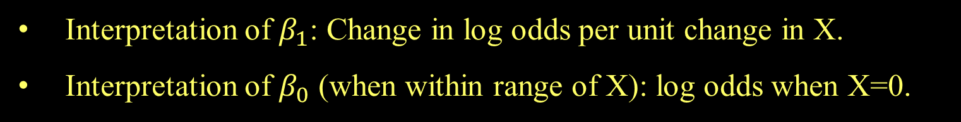
Odds and Logistic Regression
Logit form:
⇒
The logistic model assumes a linear relationship between the predictor and log(odds).
Interpretation of $β_{1}$: Change in log odds per unit change in X.
Interpretation of $β_{0}$ (when within range of X): log odds when X=0.

Slide 5





CI for Slope and Odds Ratio
Using the SE for the slope, find a CI for β₁ with
$${\hat{β}}_{1}±z^{∗}∙SE$$
To get CI for the odds ratio ($e^{β_{1}})$ exponentiate the CI for β₁
Estimate Std. Error z value Pr(>|z|)
(Intercept) 3.25684 0.36893 8.828 <2e-16 ***
Length -0.56614 0.06747 -8.391 <2e-16 ***
CI for slope:
$$−0.566±1.96(0.06747)$$
$$=(−0.698,−0.434)$$
CI for OR:
$${(e}^{−0.698},e^{−0.438})$$
$$=(0.497, 0.648)$$

Slide 6



CI for Slope and Odds Ratio
Using the SE for the slope, find a CI for β₁ with
$${\hat{β}}_{1}±z^{∗}∙SE$$
SE_B1 = summary(modPutt)$coef[2,2]
exp(B1 - SE_B1*qnorm(0.975))
exp(B1 + SE_B1*qnorm(0.975))
[1] 0.4973894
[1] 0.6479761
exp(confint.default(modPutt))
2.5 % 97.5 %
(Intercept) 12.6006177 53.5133410
Length 0.4973894 0.6479761
CI for OR:
$${(e}^{−0.698},e^{−0.438})$$
$$=(0.497, 0.648)$$

Slide 7
Recall: “Ordinary” Regression
Similar tests/measures for logistic regression?
lm(formula = Active ~ Rest)
Coefficients:
Estimate Std. Error t value Pr(>|t|)
(Intercept) 8.75340 5.60773 1.561 0.12
Rest 1.18387 0.08214 14.413 <2e-16 ***
Residual standard error: 14.39 on 310 degrees of freedom
Multiple R-squared: 0.4012, Adjusted R-squared: 0.3993
F-statistic: 207.7 on 1 and 310 DF, p-value: < 2.2e-16
Tests for individual coefficients
Compare models
Test for overall fit

Slide 8
Test for Individual Coefficients
Supplied by R
H_{o}: β_{i} = 0
H_{a}: β_{i} ≠ 0
Interpret as with individual t-tests in ordinary regression
P-value = 2P( Z > |t.s.| )
Estimate Std. Error z value Pr(>|z|)
(Intercept) 3.25684 0.36893 8.828 <2e-16 ***
Length -0.56614 0.06747 -8.391 <2e-16 ***
Notes:
Z value is the estimate / Standard error

Slide 9
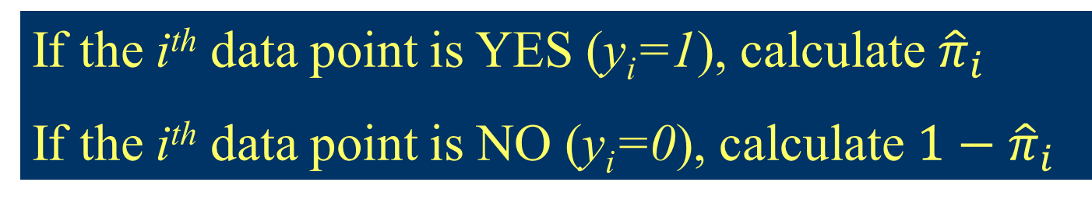
Estimating Parameters in Logistic Regression
Parameters are chosen to maximize the likelihood of the observed sample. (Maximum Likelihood Estimation)
If the i^{th} data point is YES (y_{i}=1), calculate ${\hat{π}}_{i}$
If the i^{th} data point is NO (y_{i}=0), calculate $1−{\hat{π}}_{i}$
Likelihood
Make this big

Slide 10
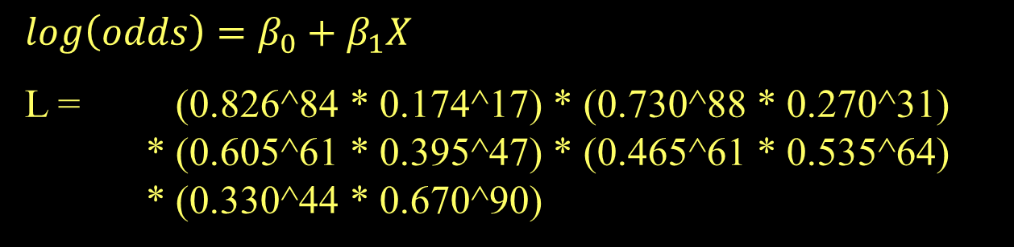
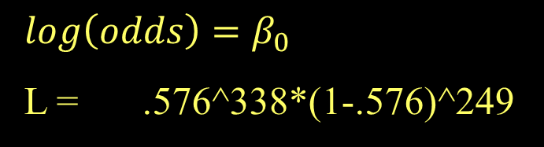
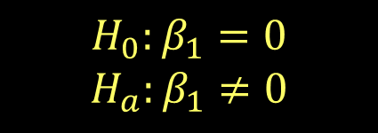
Test for Overall Fit
Length | 3 | 4 | 5 | 6 | 7
Made | 84 | 88 | 61 | 61 | 44
Missed | 17 | 31 | 47 | 64 | 90
 | 0.826 | 0.730 | 0.605 | 0.465 | 0.330
$$log\left(odds\right)=β_{0}$$
L = .576^338*(1-.576)^249
$$H_{0}:β_{1}=0$$
$$H_{a}:β_{1}≠0$$
$$log\left(odds\right)=β_{0}+β_{1}X$$
L = (0.826^84 * 0.174^17) * (0.730^88 * 0.270^31)
* (0.605^61 * 0.395^47) * (0.465^61 * 0.535^64)
* (0.330^44 * 0.670^90)

Slide 11


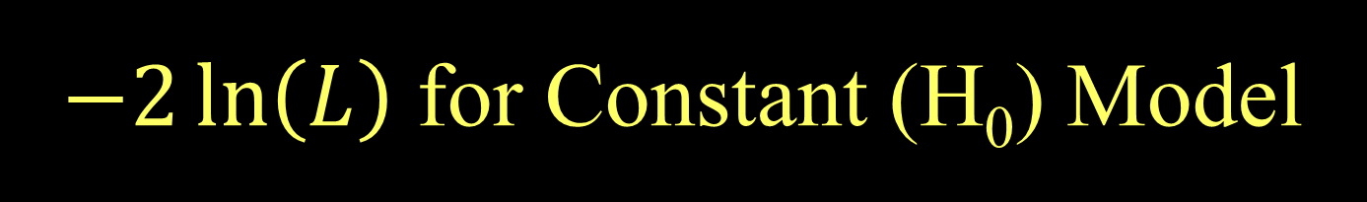
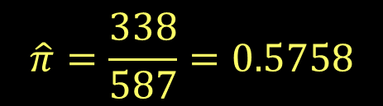
$−2\ln\left(L\right)$ for Constant (H₀) Model
For a constant model:
$$L_{0}={\hat{π}}^{\#yes}{(1−\hat{π})}^{n−\#yes}$$
$$\log\left(L_{0}\right)=\#yes∙\log\left(\hat{π}\right)+\#no∙log⁡(1−\hat{π})$$
Combining all putts: 338 made out of 587
$$\hat{π}=\frac{338}{587}=0.5758$$
$$L_{0}={0.5758}^{338}{0.4242}^{249}$$
$$\log\left(L_{0}\right)=338\log\left(0.576\right)+249\log\left(0.424\right)=−400.1$$
$$−2log\left(L_{0}\right)=800.2$$
Null deviance

Slide 12
Putts1: Made~Length
lmodPutt=glm(Made~Length,family=binomial,data=Putts1)
summary(lmodPutt)
Coefficients:
Estimate Std. Error z value Pr(>|z|)
(Intercept) 3.25684 0.36893 8.828 <2e-16
Length -0.56614 0.06747 -8.391 <2e-16
Null deviance: 800.21 on 586 degrees of freedom
Residual deviance: 719.89 on 585 degrees of freedom
Notes:
The important number is the difference between the null deviance and the residual deviance

Slide 13

Example: Golf Putts
Length | 3 | 4 | 5 | 6 | 7
Made | 84 | 88 | 61 | 61 | 44
Missed | 17 | 31 | 47 | 64 | 90
 | 0.826 | 0.730 | 0.605 | 0.465 | 0.330
$$L={0.826}^{84}{0.174}^{17}{0.730}^{88}{0.270}^{31}⋯{0.330}^{44}{0.670}^{90}$$
$\log\left(L\right)=84\log\left(0.826\right)+17\log\left(0.174\right)+⋯$ $+44\log\left(0.330\right)+90\log\left(0.670\right)=−359.9$
Coefficients are chosen to get $log(L)$ as big as possible
$$−2log\left(L\right)=719.8$$
Minimize residual deviance
Notes:
13
If you don’t multiply by -2 then you can’t use the table

Slide 14
Putts1: Made~Length
lmodPutt=glm(Made~Length,data=Putts1,family=binomial,data=Putts1)
summary(lmodPutt)
Coefficients:
Estimate Std. Error z value Pr(>|z|)
(Intercept) 3.25684 0.36893 8.828 <2e-16
Length -0.56614 0.06747 -8.391 <2e-16
Null deviance: 800.21 on 586 degrees of freedom
Residual deviance: 719.89 on 585 degrees of freedom
How much “improvement” with the predictor?
$$−2\log\left(L_{0}\right)−\left(−2\log\left(L\right)\right)=800.2−719.99=80.3$$
This difference is called the G statistic.

Slide 15
Evaluating Overall Fit
Test for overall fit
(Similar to regression ANOVA)
t.s. = G = improvement in –2log(L) over a model with just a constant term
Compare to χ² with k d.f. (chi-square)
# predictors
Null deviance: 800.21 on 586 degrees of freedom
Residual deviance: 719.89 on 585 degrees of freedom
$$G=800.2−719.9=80.3$$
1-pchisq(80.3,1)
[1] 0
p-value ≈ 0, Reject H₀
Notes:
In the code 80.3 is the G stat and the 1 is the degrees of freedom

Slide 16
Evaluating Overall Fit
H_{o}: β_{i} = 0
H_{a}: β_{i} ≠ 0
Null deviance: 800.21 on 586 degrees of freedom
Residual deviance: 719.89 on 585 degrees of freedom
$$G=800.2−719.9=80.3$$
1-pchisq(80.3,1)
[1] 0
anova(modPutt, test="Chisq")
Df Deviance Resid. Df Resid. Dev Pr(>Chi)
NULL 586 800.21
Length 1 80.317 585 719.89 < 2.2e-16 ***
Notes:
Deviance is the g-stat

